Slide 1
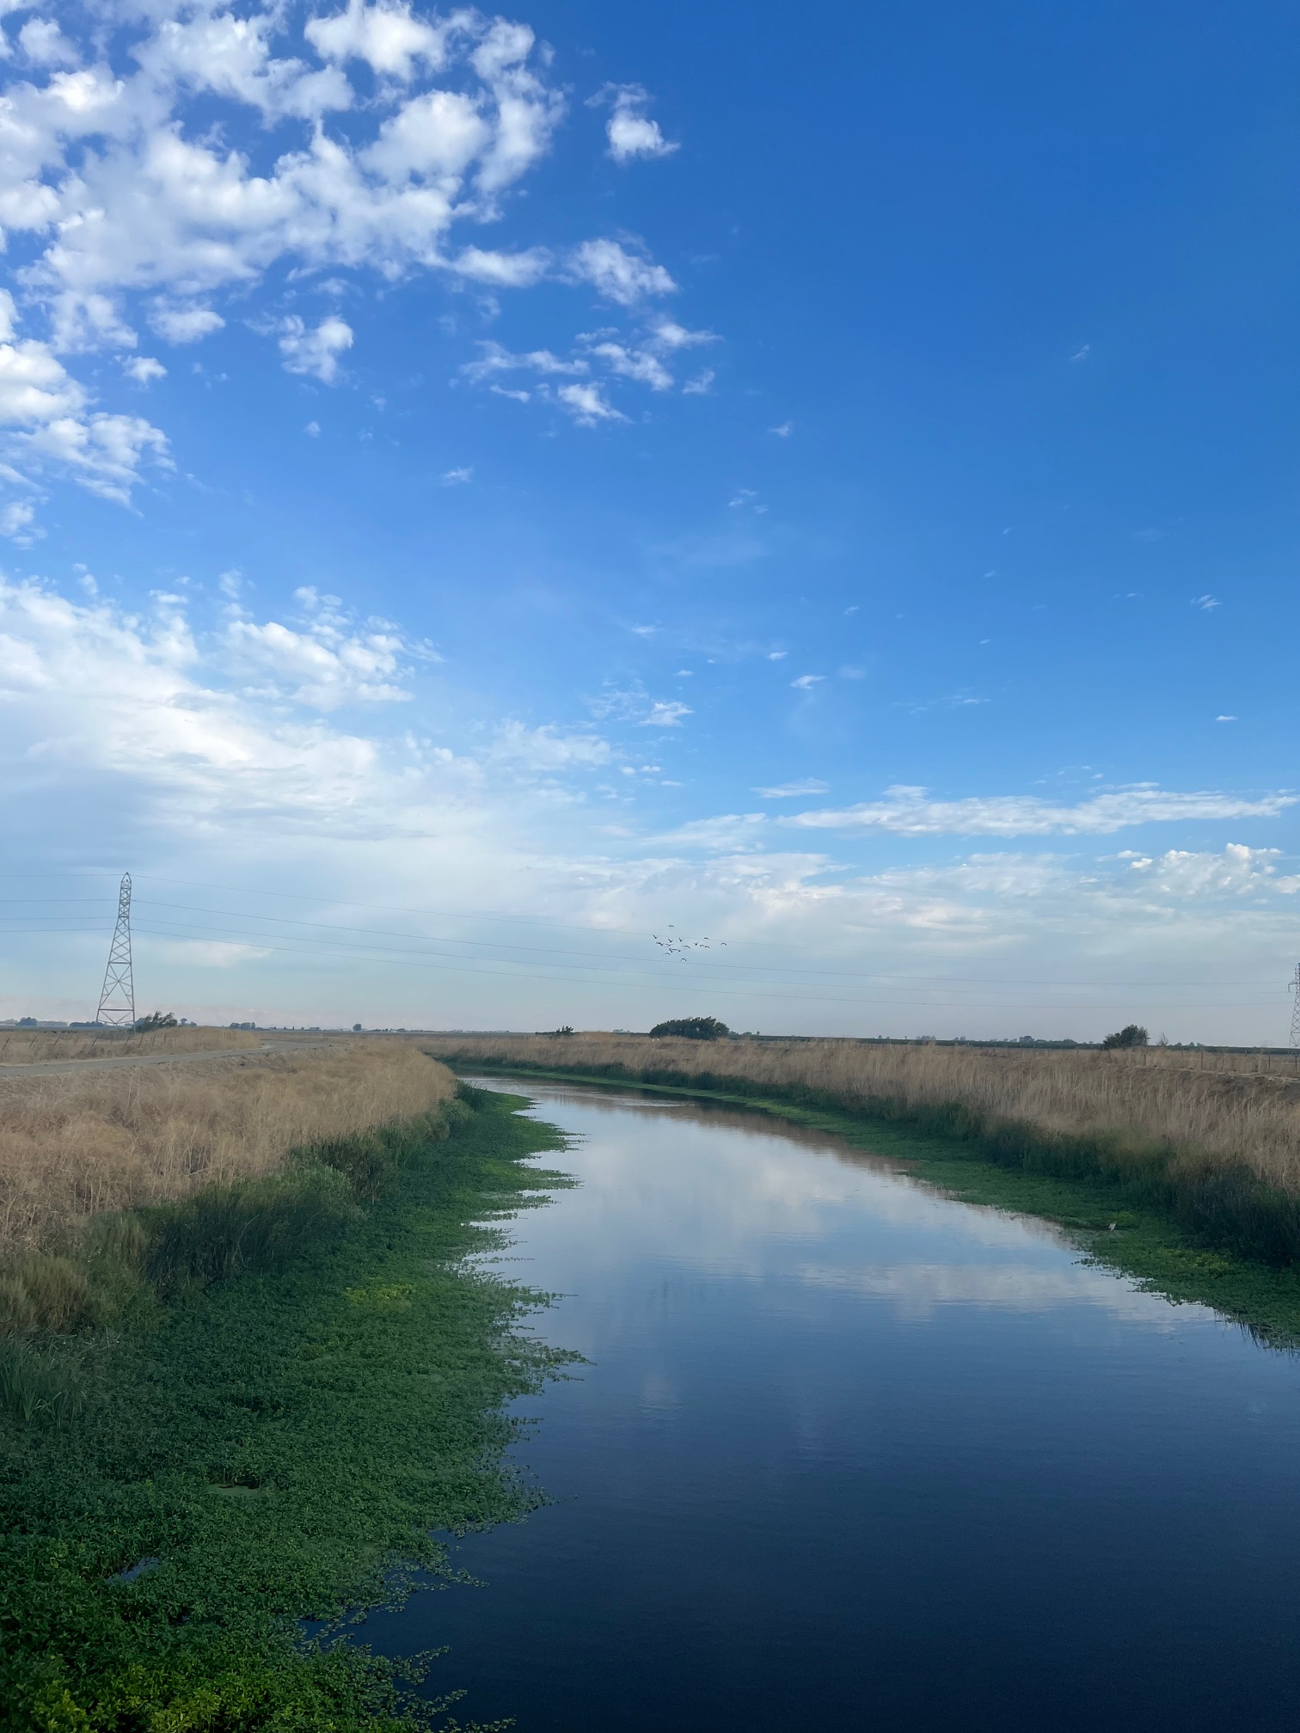
Grower Meeting: Exceedances of the water quality objectives for pyrethroid pesticides
Dixon/Solano RCD
Water Quality Coalition
August 13, 2025
Ulatis Creek

Slide 2
Agenda
Martha McKeen, Dixon RCD
Introduction and purpose of the meeting
History of the pyrethroids monitoring at Ulatis Creek
Sediment Toxicity Management Plan at Ulatis Creek/Brown Road
Mike Trouchon, LWA – Larry Walker Associates
Technical and statistical data on pyrethroids
Required reporting
Franz Niederholzer, UCCE Farm Advisor – Colusa/Sutter/Yuba
BMPs of pyrethroids pesticides in almonds and other crops

Slide 3
Agenda
Panelist for open discussion and Q & A:
Matthew Carl, Solano County Deputy Ag Commissioner
Sudan Gyawaly, UCCE Integrated Pest Management Advisor-Butte County
Franz Niederholzer, UCCE Farm Advisor – Colusa/Sutter/Yuba
Martha McKeen, Dixon RCD Program Coordinator
Mike Trouchon, LWA – Larry Walker Associates
Wrap up meeting with final thoughts at 11:30 am

Slide 4
Meeting checklist
In person: Please silence your phones.
Online: Use the mute button. *6 - Toggle mute/unmute
Please use the sign in sheet or the chat to log your attendance.
Lunch (pizza) will be here at approximately 11:15 am.
Feel free to stay for the Dixon RCD board meeting at noon.
Bathroom entry codes are posted near the hall exit.
Q & A will be at the end of the presentation, but feel free to raise you hand if you have a questions anytime during the meeting.
We will be recording the meeting.

Slide 5
Meeting “what and whys”
Why? Because we had an exceedance of the water quality objectives for pyrethroids.
Why? Dixon/Solano has one representative monitoring site, Ulatis Creek at Brown Road therefore results represent all growers in our subwatershed collectively.
Why? Because we are in a management plan (MP) for pyrethroids.
Why? Outreach and targeted training for pyrethroid users is a commitment in the MP that has been approved by the Regional Water Quality Control Board therefore is a requirement of the program.
Why? Because you use pyrethroids.
What? Do not point fingers at any one grower.
What? Refresher on the history at Ulatis Creek and hear about the recent exceedances.
What? Reminder of best practices.
What? Learn other grower’s practices near waterways.
What? Share experiences, ideas and concerns.

Slide 6
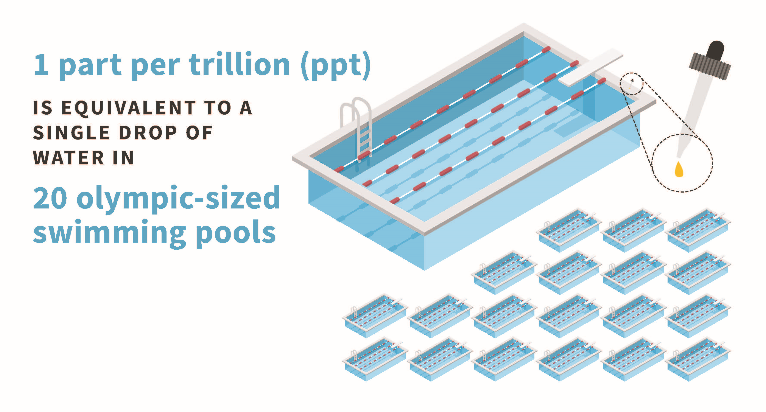
Pyrethroids: Quantity to cause an exceedance

Slide 7
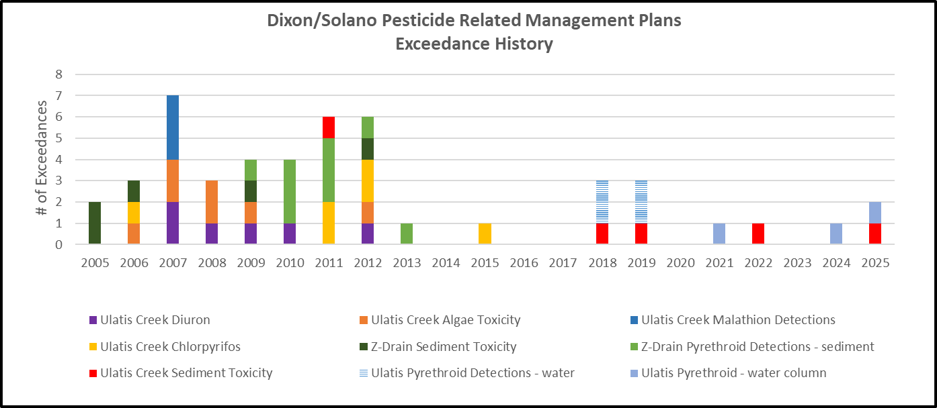
History of Ulatis Creek
Notes:
More than 1,000 pyrethroid insecticides have been synthesized since 1953 when Allethrin was first created by USDA scientists.
Synthetic pyrethroids are developed to mimic a compound name pyrethrum which is a natural insecticide produced by chrysanthemums.

Slide 8
Exceedance Events at Ulatis Creek
Notes:
More than 1,000 pyrethroid insecticides have been synthesized since 1953 when Allethrin was first created by USDA scientists.
Synthetic pyrethroids are developed to mimic a compound name pyrethrum which is a natural insecticide produced by chrysanthemums.

Slide 9
Pyrethroid Exceedances: Timeline of the active Management Plan for Sediment Toxicity at Ulatis Creek/Brown Road (UCBRD) monitoring site
Pyrethroid exceedance
2019
Pyrethroid exceedance
Triggered MP
2020
2018
2021
2022
2023
2024
Zero exceedances
Zero exceedances
Exceedance DNQ, extended MP an additional 3 years to 2025
Zero exceedances
Zero Exceedances
2025
Exceedance DNQ extends MP an additional 3 years to 2028

Slide 10
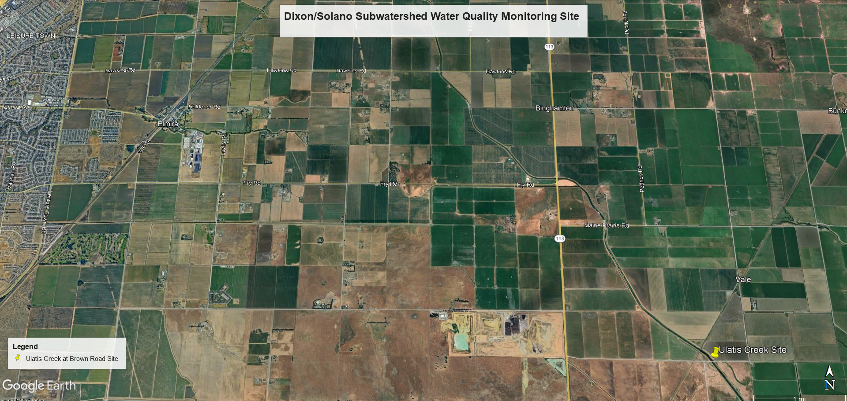
Urban
Agriculture
Commercial
Municipal
In communication with the Solano Ag Commissioner’s office and entities such as the Easterly Wastewater facility.
Shared with the Regional Board that all entries drain into the D/S subwatershed representative monitoring site.

Slide 11
Overview of a Management Plan (MP)
Environmental concerns
Program costs increase
Increased water quality monitoring
Additional outreach and training
Additional report writing and analysis by consultants
Additional farm reporting
SW MPIR-Surface Water Management Practices Implementation Report

Slide 12
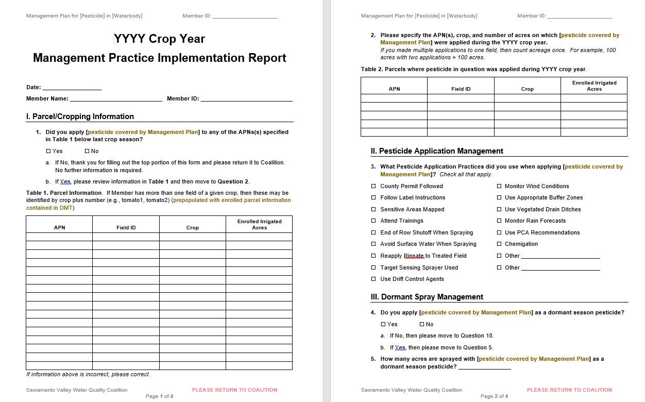
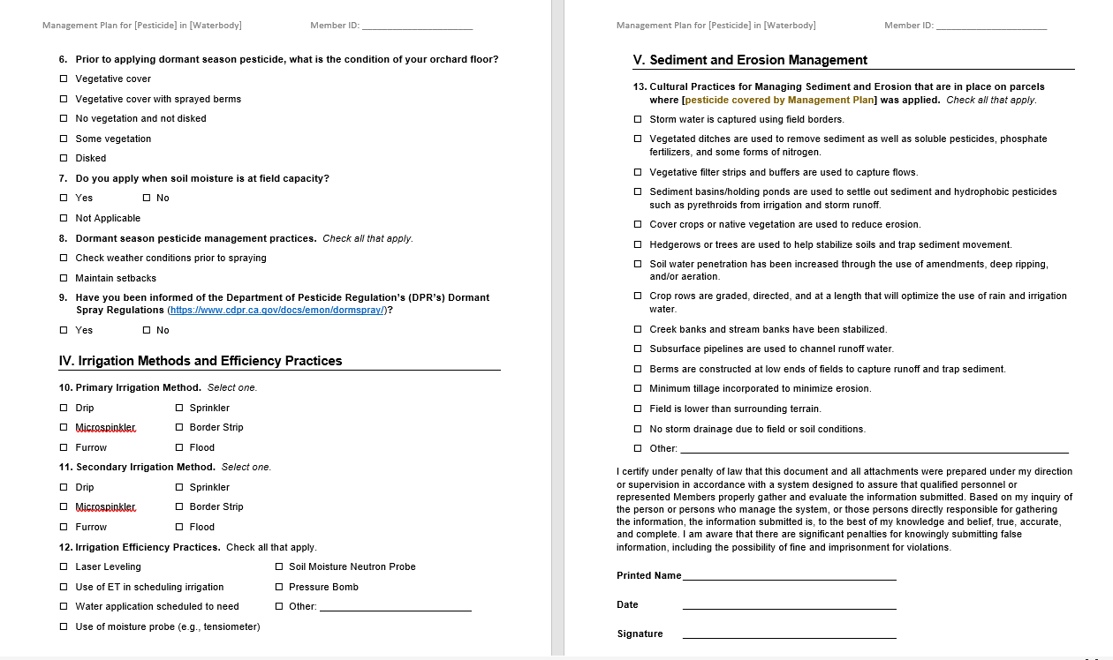
SW MPIR-Surface Water Management Practices Implementation Report
Being developed now in the online DMT (data management tool) for crop year 2025
Displayed is the generic, blank template approved by the Regional Board in 2020

Slide 13
Mike Trouchon
Larry Walker Associates

Slide 14
Water Quality Monitoring in the DS Subwatershed
Water quality monitoring in the Dixon-Solano Subwatershed is based on two primary criteria:
Irrigated Lands Regulatory Program Pesticides Evaluation Protocols (PEP).
Water quality issues identified from prior monitoring by the Sacramento Valley Water Quality Coalition.

Slide 15
Water Quality Monitoring in the DS Subwatershed
2016 Pesticides Evaluation Protocol (PEP):
The Coalition is required to monitor for specific registered pesticides based on their application rate (use) in a specific drainage.
Each registered pesticide is assigned a relative risk score based on its toxicity to humans or aquatic organisms
How does Pesticide Evaluation Protocol determine monitoring?
Pesticide A: little use and low toxicity = won’t be monitored
Pesticide B: little use and high toxicity = will be monitored
Pesticide C: high use and little toxicity = a formula is used to determine monitoring
Pesticide D: high use and high toxicity = will be monitored

Slide 16
Water Quality Monitoring in the DS Subwatershed
Water quality issue(s) identified from prior monitoring:
Prior monitoring for a parameter showed one exceedance:
Single Exceedance Monitoring.
Prior monitoring for a parameter showed two or more exceedances in a 3-year period:
This scenario would mean that a Management Plan (MP) was triggered and there would be MP monitoring until the Management Plan was completed.
The soonest a Management Plan can be completed is in 3 years if there are no more exceedances for the parameter in question.

Slide 17
Water Quality Monitoring in the DS Subwatershed
What’s an exceedance? An exceedance of what?
An exceedance of a water quality objective (WQO).
A WQO is a numeric value (based on science) that may cause harm to humans or aquatic organisms.
There are 112 water quality objectives in total that DS monitoring data are compared to if/when a given parameter with a WQO is monitored.

Slide 18
Monitoring for Pyrethroid Pesticides
The six pyrethroids include:
Bifenthrin*
Cyfluthrin
Cypermethrin
Esfenvalerate
Lambda-Cyhalothrin*
Permethrin
Each of these six pyrethroids show different levels of toxicity: Bifenthrin > Lambda-Cyhalothrin > Cypermethrin > Cyfluthrin > Esfenvalerate > Permethrin
*Bifenthrin and Lambda-Cyhalothrin pyrethroid pesticides that were determined to have caused the exceedances at UCBRD and are what triggered our MP.
Notes:
More than 1,000 pyrethroid insecticides have been synthesized since 1953 when Allethrin was first created by USDA scientists.
Synthetic pyrethroids are developed to mimic a compound name pyrethrum which is a natural insecticide produced by chrysanthemums.

Slide 19
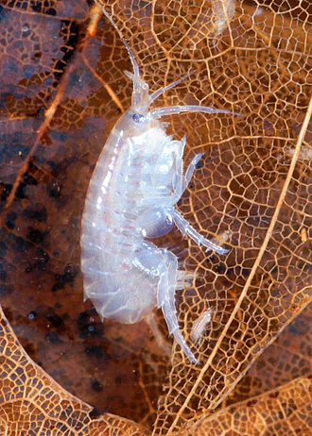
Monitoring for Pyrethroid Pesticides
Pyrethroids are:
Highly toxic at very low concentrations to amphipods, such as Hyalella azteca, that are eaten by waterfowl and fish.
Tightly bound to organic matter in the water column making them less toxic to critters as organic carbon concentrations increase.
The Central Valley Pyrethroids Control Program identifies six pyrethroids for analysis and requires that the toxicity of each one be added together to determine if concentrations are collectively toxic to test organisms (i.e., Hyalella).
Hyalella azteca
Notes:
More than 1,000 pyrethroid insecticides have been synthesized since 1953 when Allethrin was first created by USDA scientists.
Synthetic pyrethroids are developed to mimic a compound name pyrethrum which is a natural insecticide produced by chrysanthemums.

Slide 20
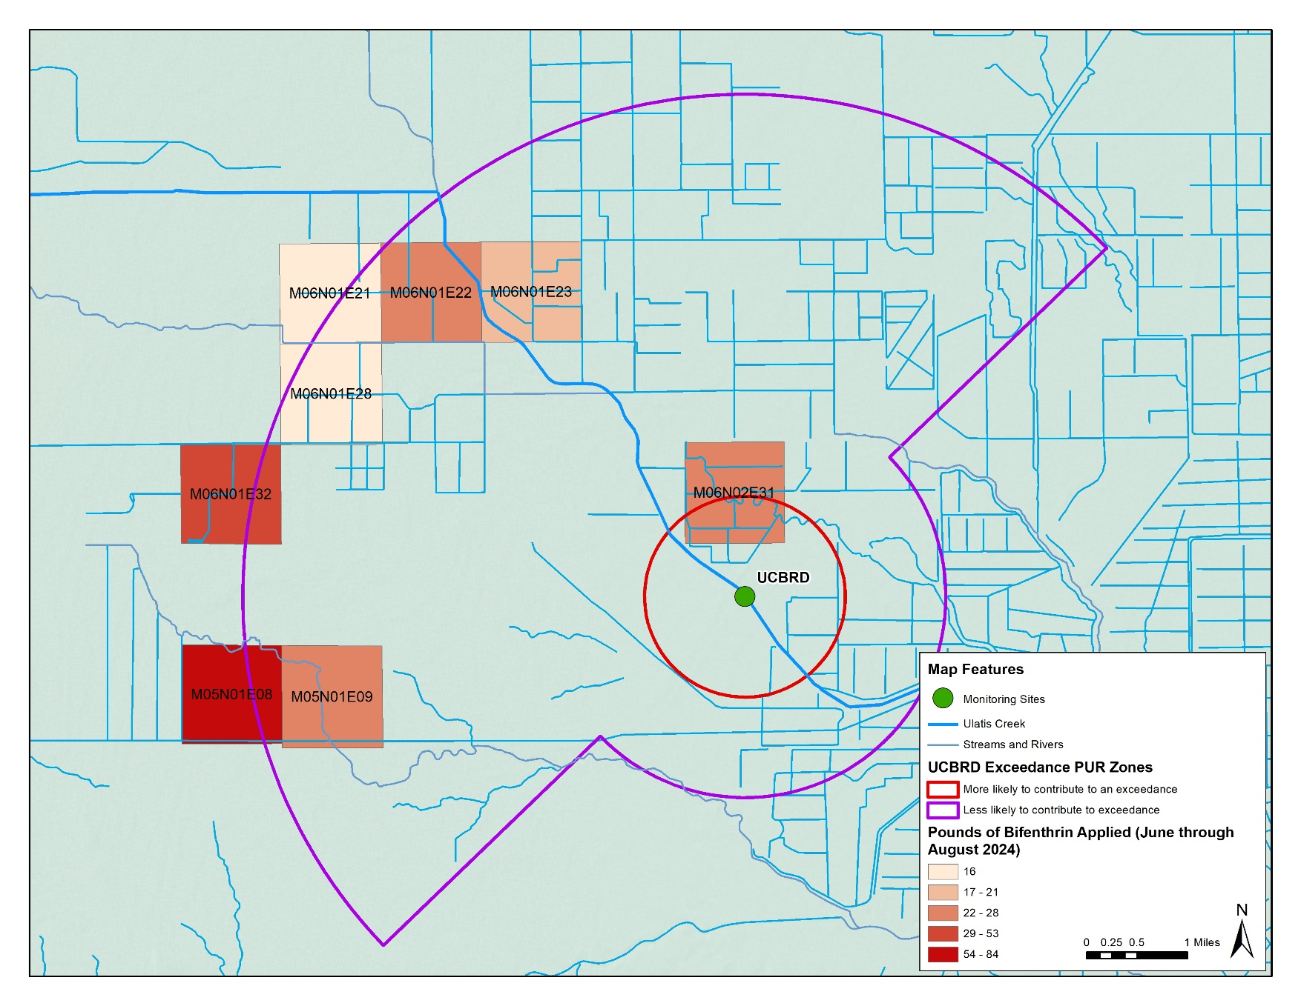
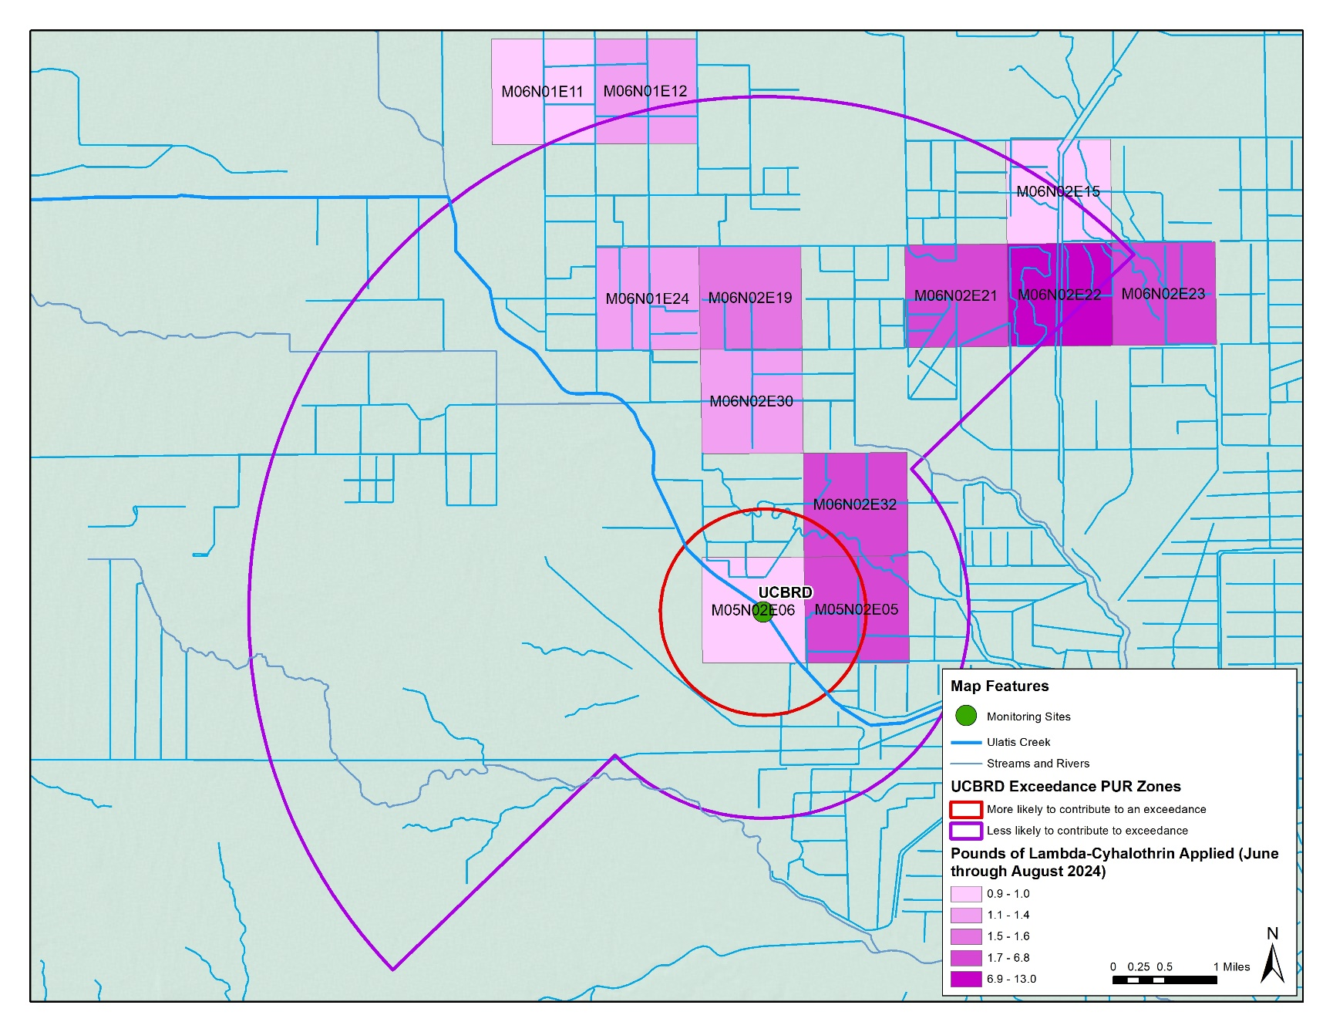
Pyrethroid Water Column Exceedances
Bifenthrin Application
Lambda-Cyhalothrin Application
Mapped AG application of bifenthrin and lambda-cyhalothrin. Each square represents one section equal to 1 square mile.

Slide 21
Pyrethroid Sediment Toxicity Monitoring

Slide 22
Pyrethroid Water Column Monitoring

Slide 23
Franz Niederholzer
UCCE Farm Advisor – Colusa/Sutter/Yuba Counties

Slide 24
Where do pyrethroids fit in CA ag?
Pyrethroids are effective.
Pyrethroids are the only real option for leaf footed and/stink bug control.
Pyrethroids are relatively inexpensive (if you don’t consider added mite risk).
How to keep using pyrethroids?

Slide 25
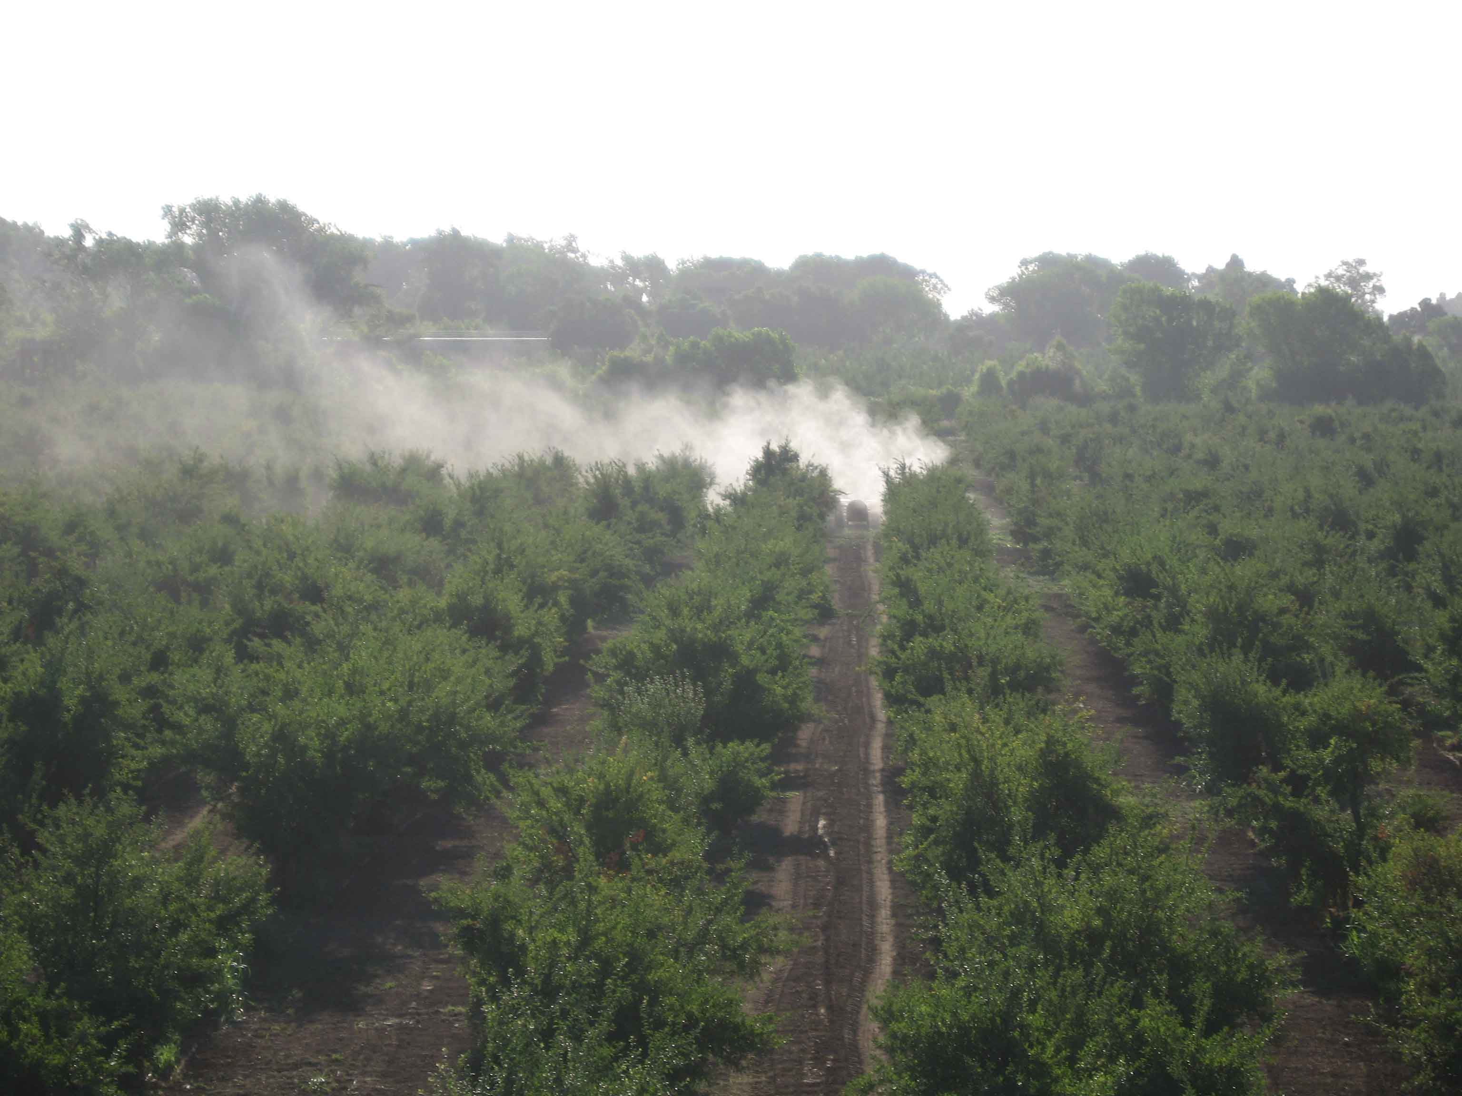
Notes:
This is an extreme case (only fertilizer in the tank) to make a point, but I think this is the primary path of pyrethroids into waterways including Ulatis Creek.

Slide 26
What can growers to control drift, particularly pyrethroid drift from airblast sprayers?
Droplet size (large drops fall fast)
Operator attention
Planning, pesticide selection
Fan output

Slide 27
Issue/problem (by “ease” of doing) | Possible solution (partial or full)
Driver attention | Row end shut off. Make bloom shut off easy. (cab location of switches) Operators know to shut down or move fields if wind changes.
Planning | Don’t spray near road/creek w chance of wind towards those vulnerable sites. Alt materials? Altacor? Intrepid? B.t.?
Droplet size | Low drift nozzles More GPA = better coverage in spring-summer.
Fan output | 10-20% less engine/PTO speed, keep tractor speed slow. [needs testing in season]

Slide 28
Gravity works quickly on spray droplets. The amount of spray fallout is greatest near the sprayer.
It is very hard to eliminate measurable drift within <100’ of the orchard when spraying large trees in summer.
Notes:
These are data showing pesticide collected on sheets of card stock paper on the ground at set distances from hull split sprays in Colusa Co in 2014.
The large droplets weigh more and drop out of the airstream as it slows down away from the sprayer.
That means pushing spray high into dense canopies with the crop high in those places

Slide 29
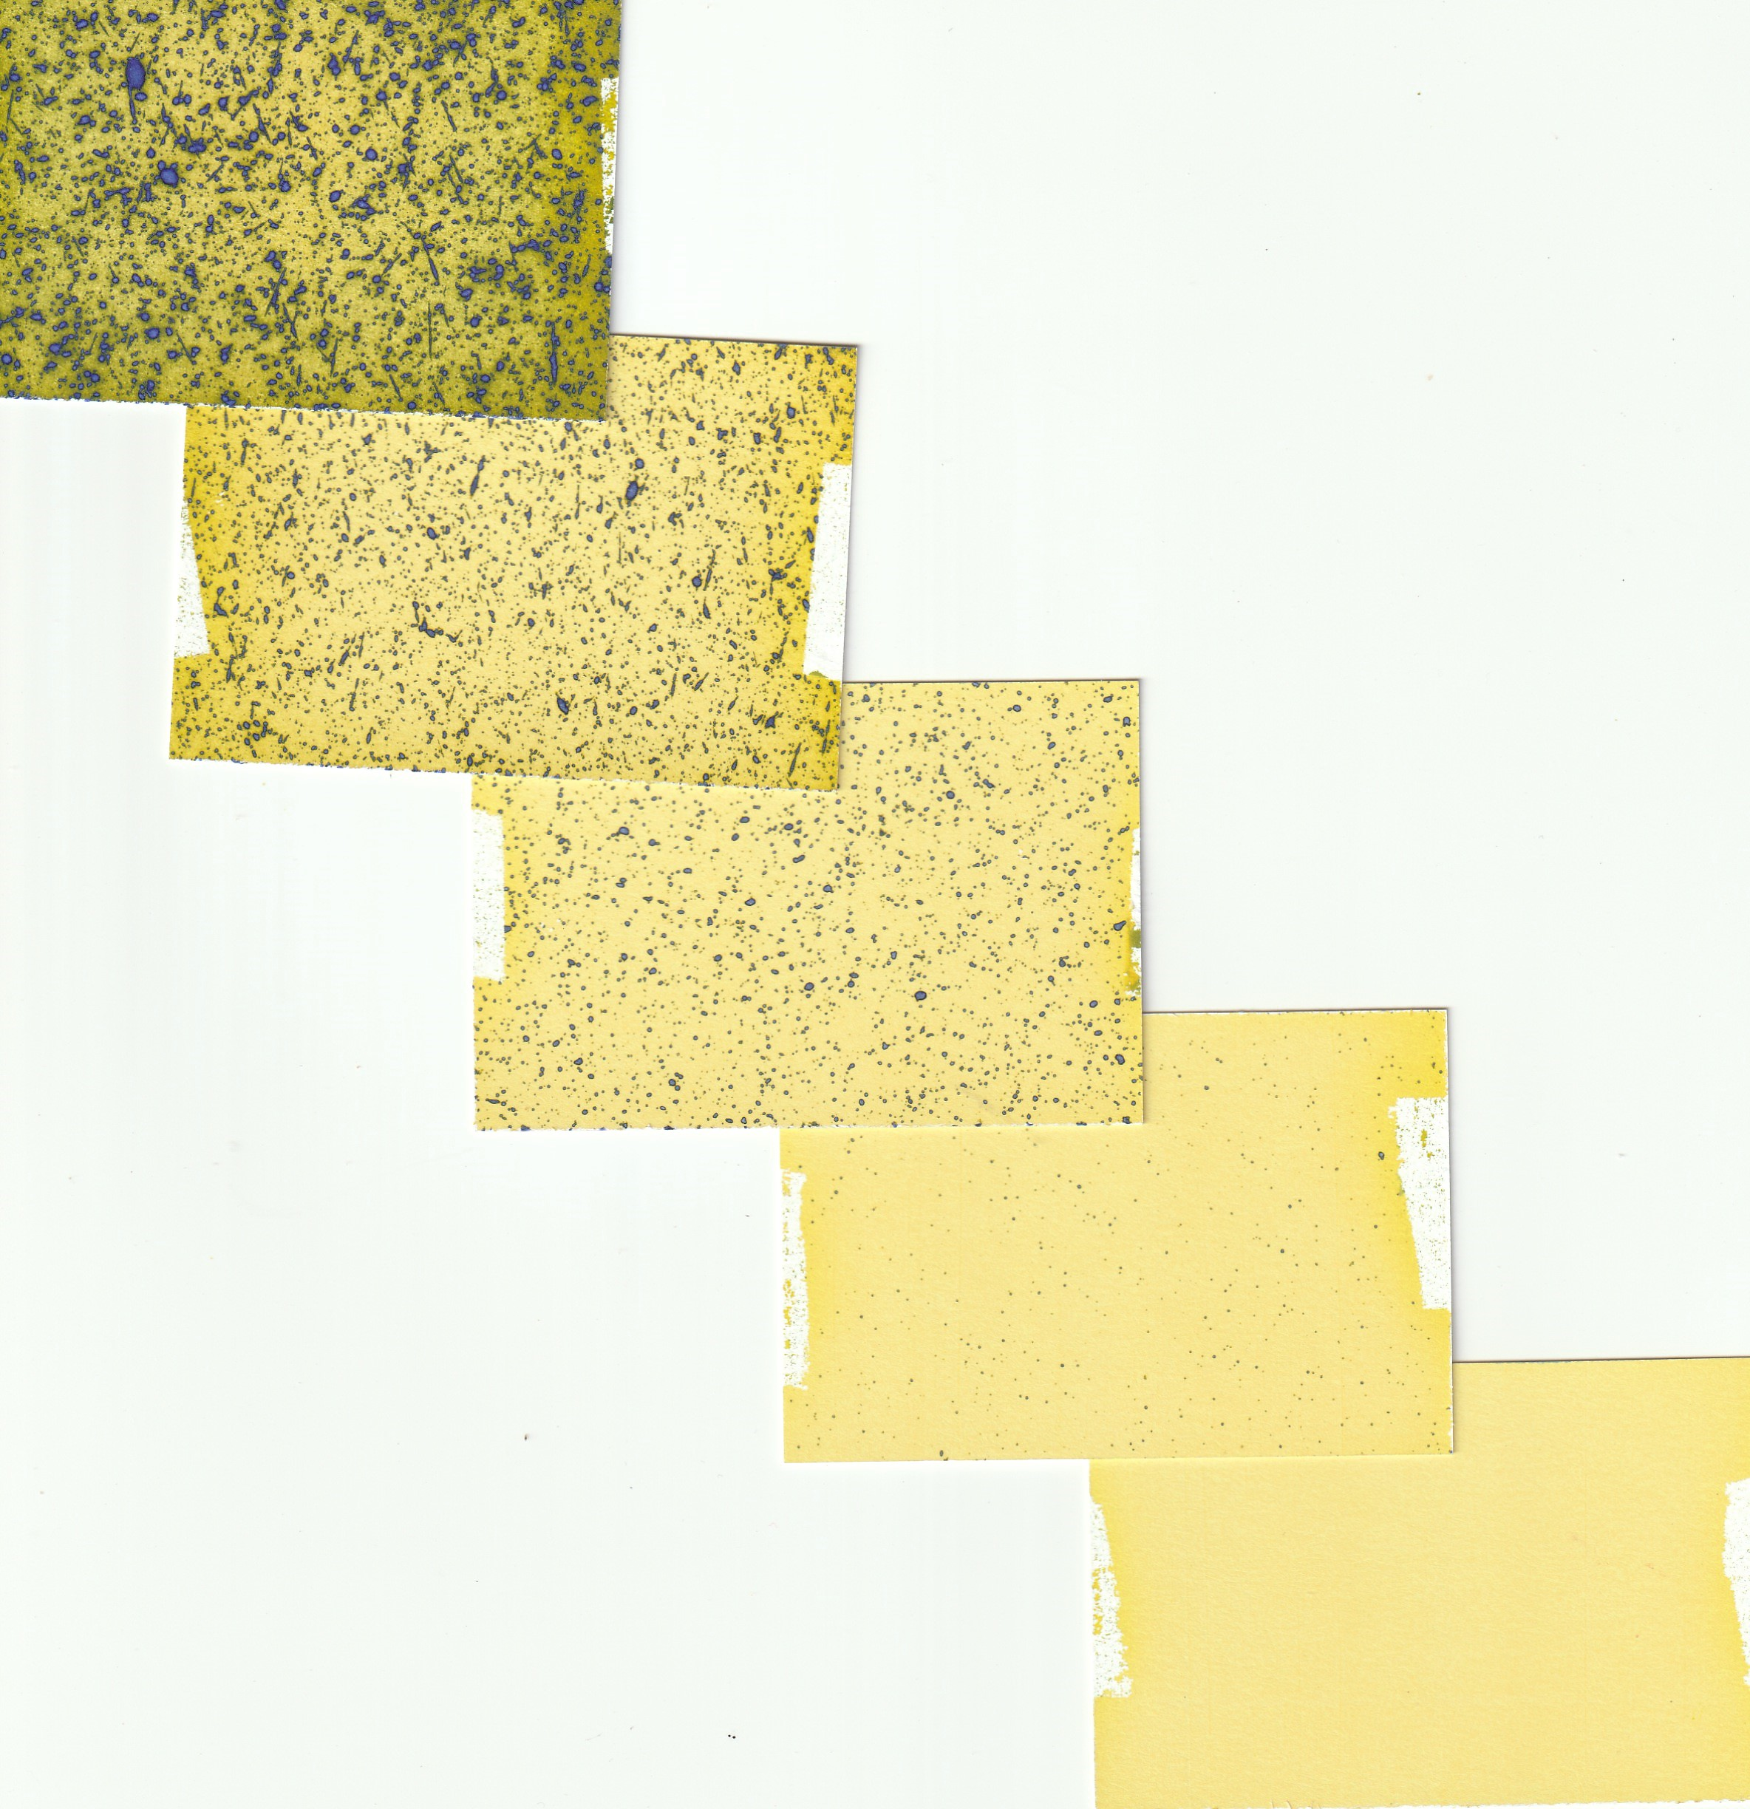
0’
NOW spray -- 170 GPA
D4 & D6 nozzles, D45 swirl plates, 100 psi
2 MPH, 540 PTO RPM
38” fan, Rears Powerblast
25’
50’
100’
200’
Spray drift from spraying the first 3 rows of a mature, productive almond orchard.

Slide 30
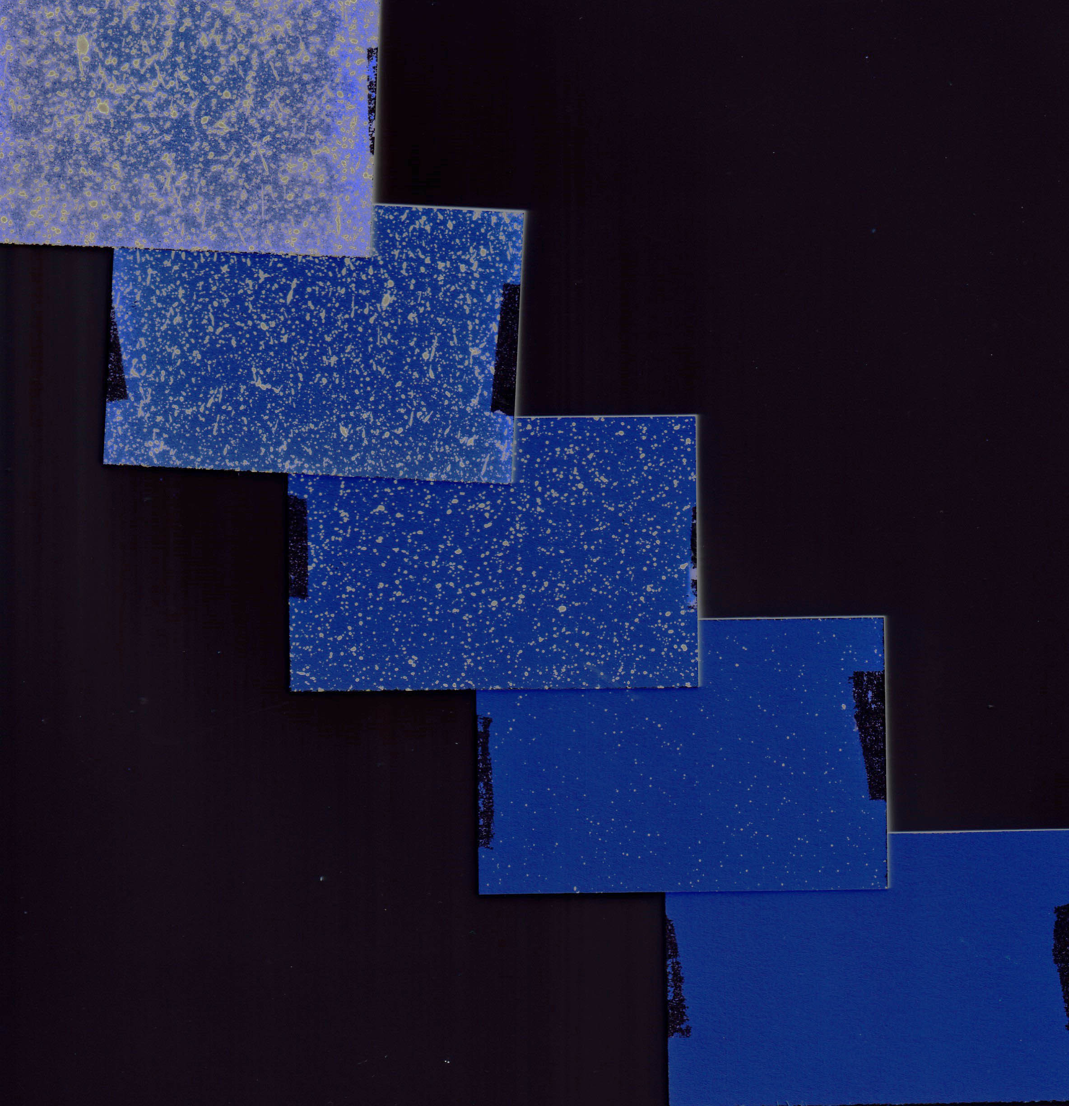
Measurable drift at 100’
170 GPA
D4 & D6 nozzles, D45 swirl plates
2 MPH, 540 PTO RPM
38” fan, Rears Powerblast
100 psi

Slide 31
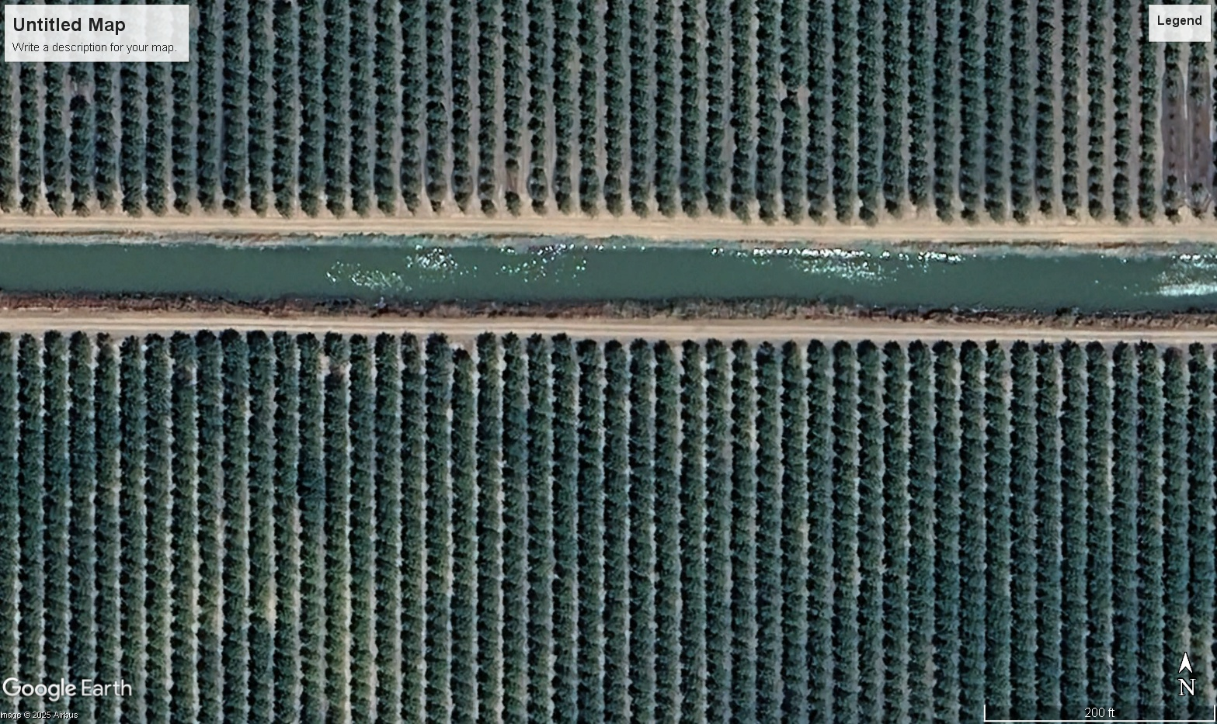
Since most drift fall out occurs near the sprayer (assuming wind not an issue), the highest drift risk is when the sprayer is working near the orchard edges.
Notes:
100’ is under 5 trees into an orchard.

Slide 32

Examples: What’s on the spray drift management menu in nut crop orchards?

Slide 33
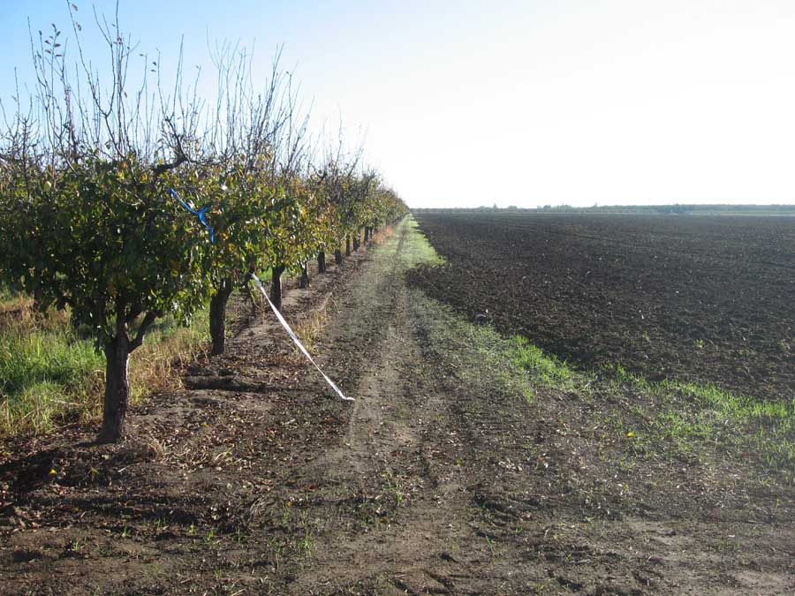
Watch wind direction…

Slide 34
Single biggest drift risk factor: wind towards field edge.
No fix to that situation in current systems (tree size)

Slide 35
End of row shut off…

Slide 36
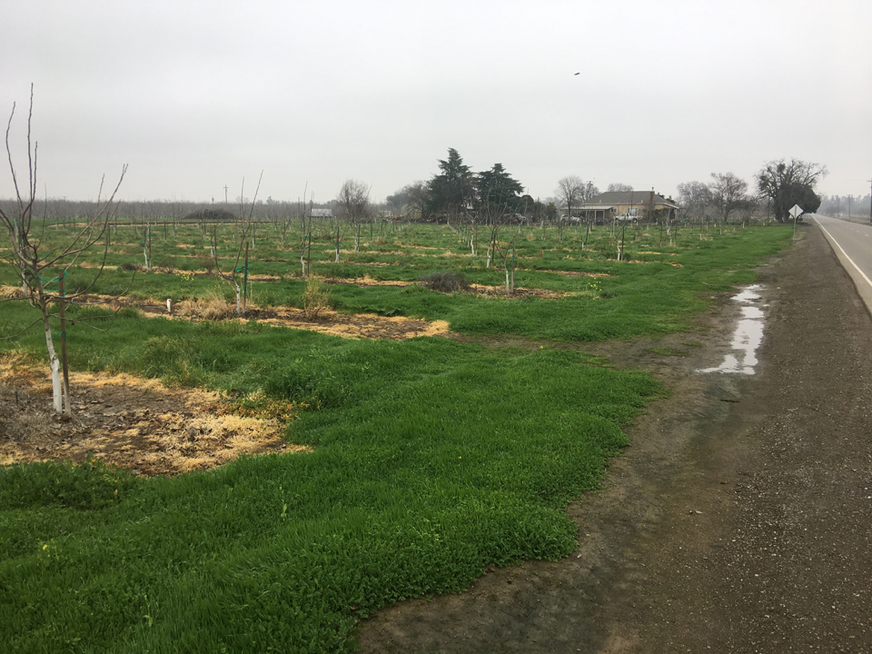
Suggested farm policy: always turn off booms on row ends. All spraying.

Slide 37
Droplets sizes… Nozzle selection determines droplet sizes (spray quality)…

Slide 38
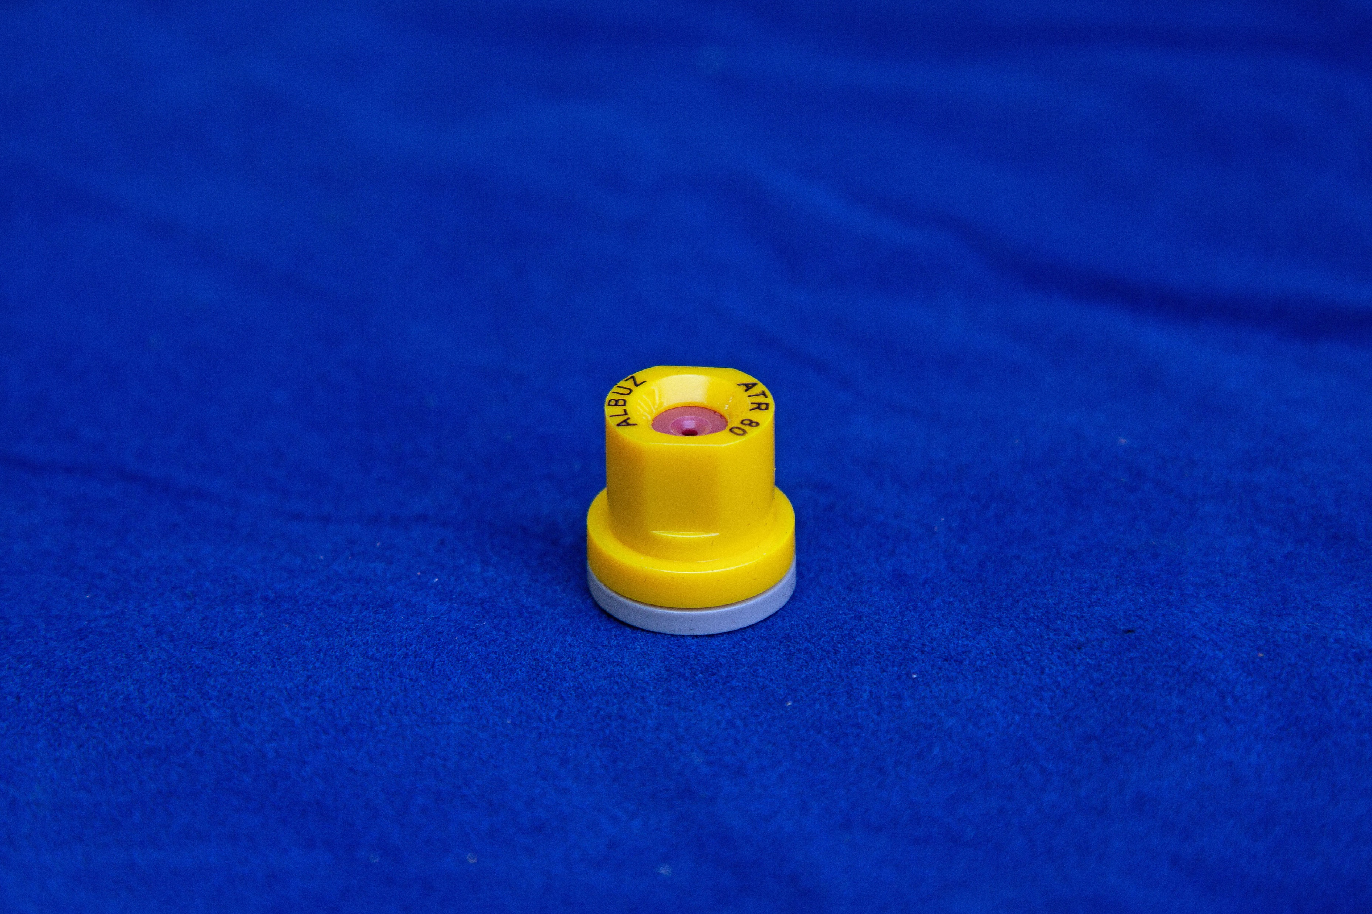
Hollow cone nozzle, color coded
Very fine/fine droplets,
Super efficient delivery potential
High spray volume needed for almond at hull split

Slide 39
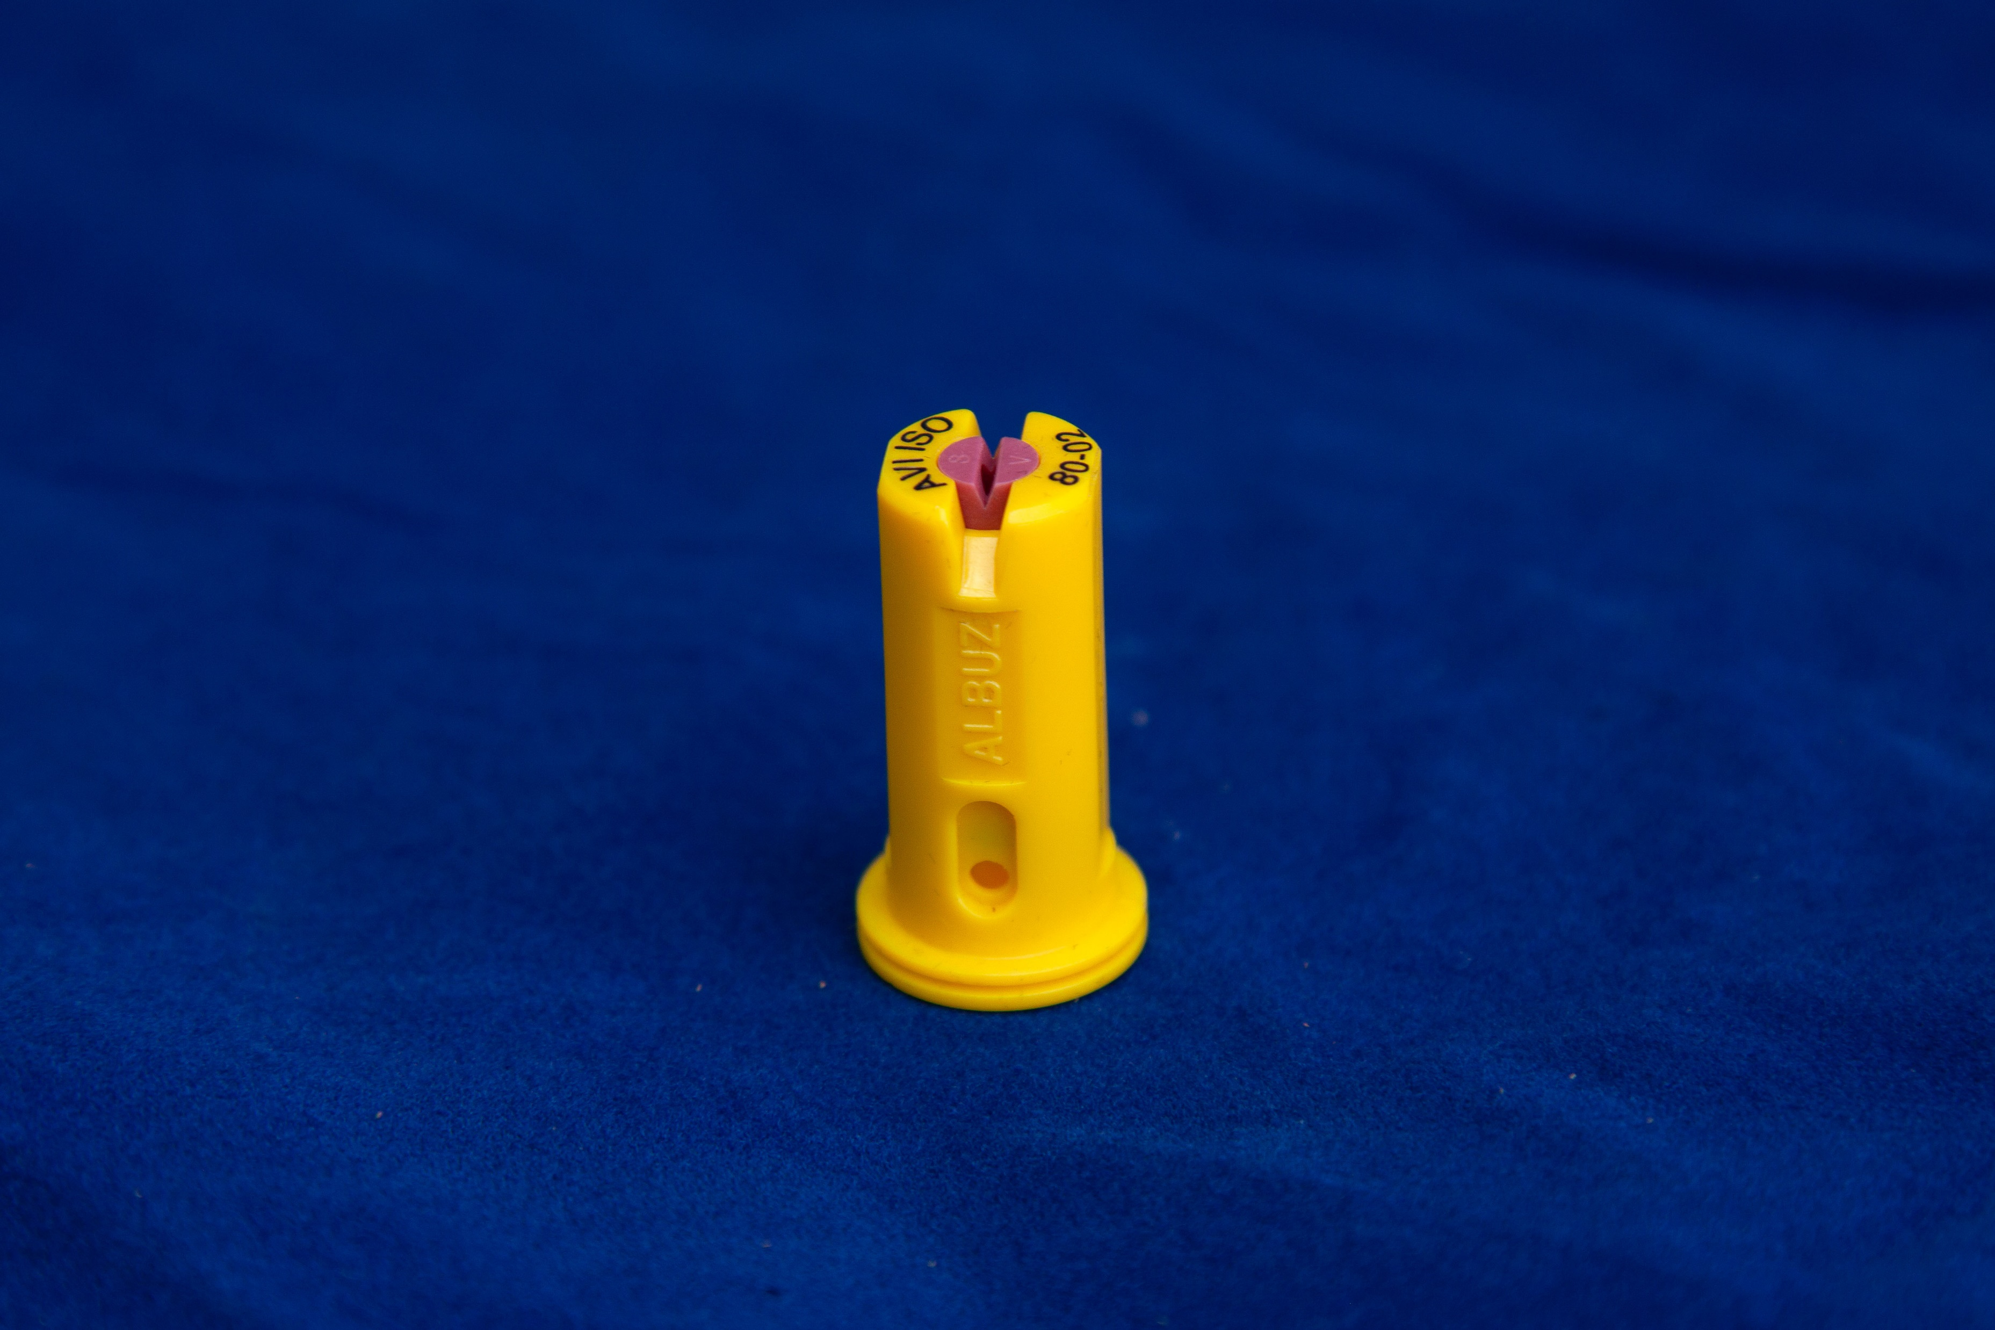
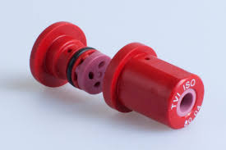
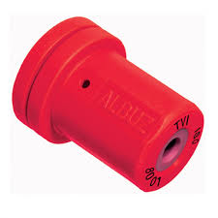
Flat fan, venturi ported, color coded
Hollow cone, venturi ported, color coded
Coarse droplets,
Excellent drift management

Slide 40
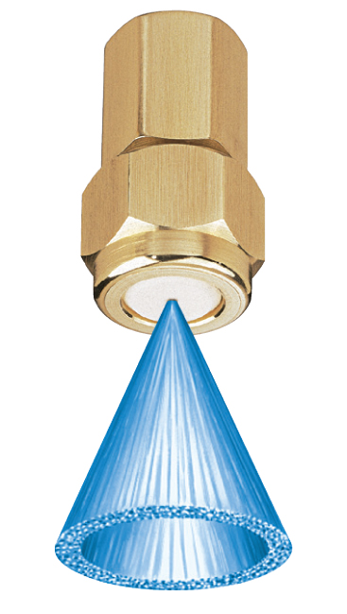
Larger nozzles (D8+) and D45 swirl plates make larger droplets than smaller (D2-4/D25).

Slide 41
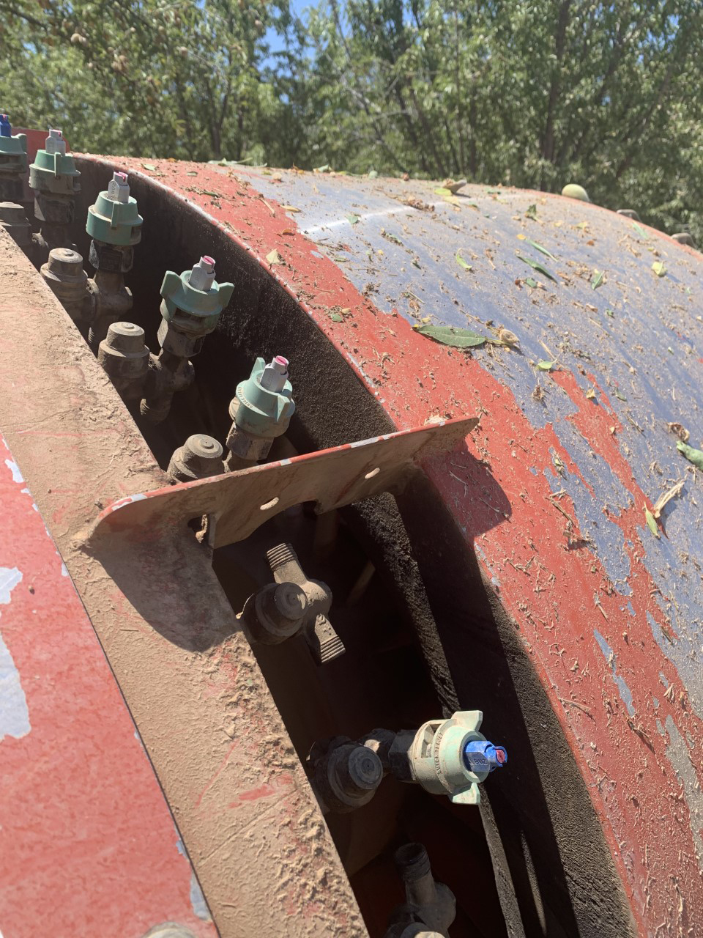
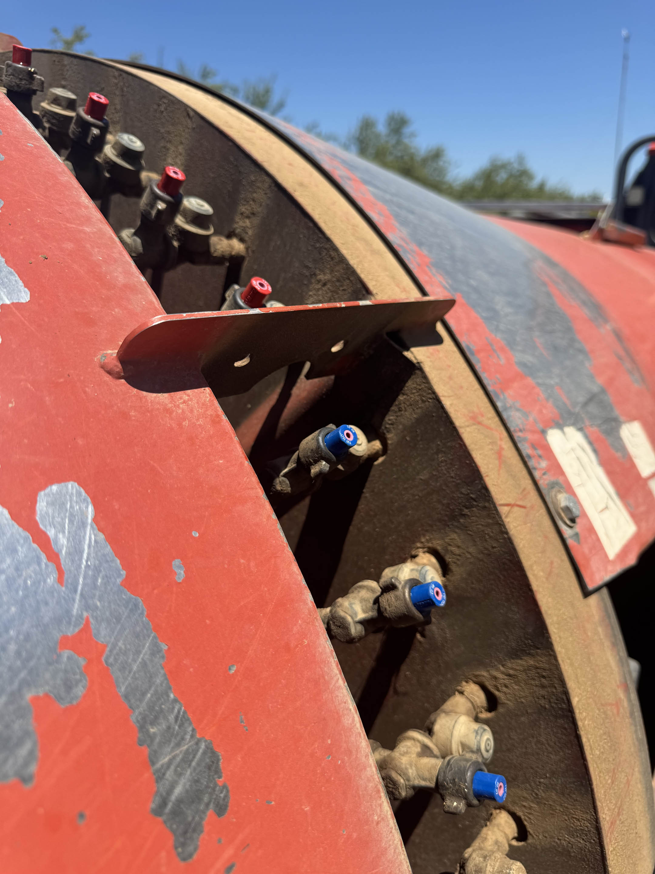
Venturi/AI nozzles control NOW, especially at high spray volumes (150-200 gpa).

Slide 42
Proven fix for some situations
Need 2 sprayers
Rows parallel to creek or road
Common practice by custom operators in Fresno County
Cap outside half of air outlet

Slide 43
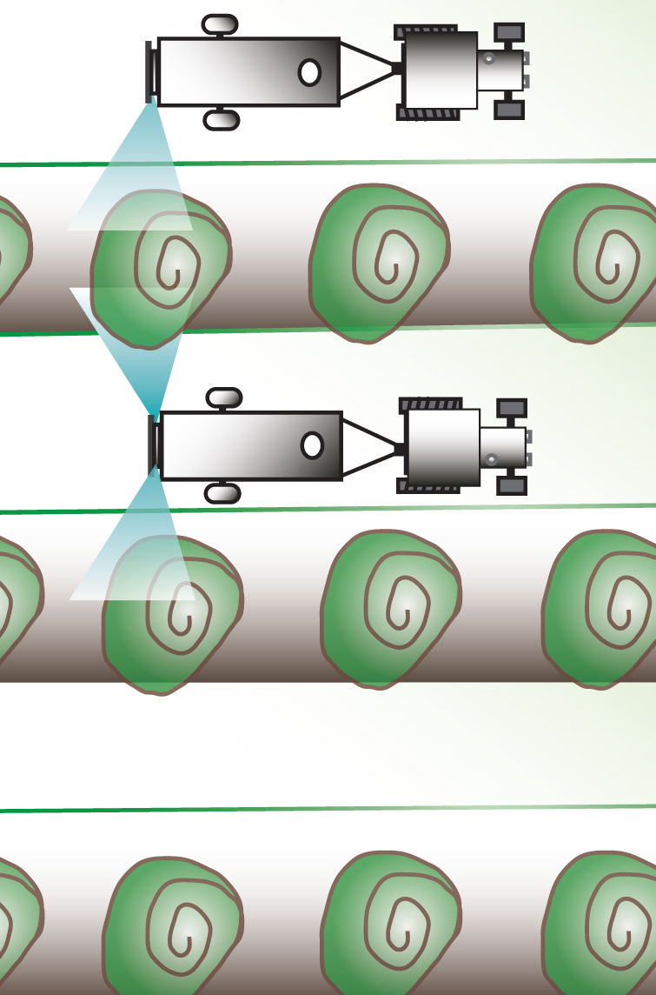
Second sprayer’s fan air controls spray drift when rows parallel to property line.
County Road
Fan on, nozzles off
Fan on, nozzles on

Slide 44
Thank you!
Franz Niederholzer
(530) 218-2359 cell
fjniederholzer@ucanr.edu

Slide 45


Open Discussion/Q & A
Notes:
More than 1,000 pyrethroid insecticides have been synthesized since 1953 when Allethrin was first created by USDA scientists.
Synthetic pyrethroids are developed to mimic a compound name pyrethrum which is a natural insecticide produced by chrysanthemums.

Slide 46
Final Thoughts…
Use BMPs when using pyrethroids
Use extreme caution near waterways
Consider use of alternate products, especially near waterways
Materials and recording will be posted on our website within the next week.
dixonrcd.org/ulatis-sediment-toxicity
We know it is a busy time, thank you for attending!
Additional questions: Martha McKeen
martha-mckeen@dixonrcd.org
707.678.1655 x103

